Slide 1
Stories are the secret sauce to delivering business value
Requirements can be interpreted in different ways and stories allow for the removal of ambiguity
Knowing who is using the software is just as important as what is being built
It’s important to know why we are building even the smallest incremental piece of software
Stories

Slide 2
Customer
Auditor
Regulatory/Compliance
Marketing
Technology (other applications)
Include stories for all roles

Slide 3
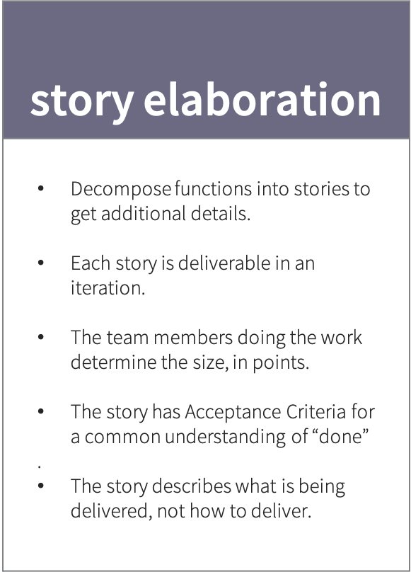
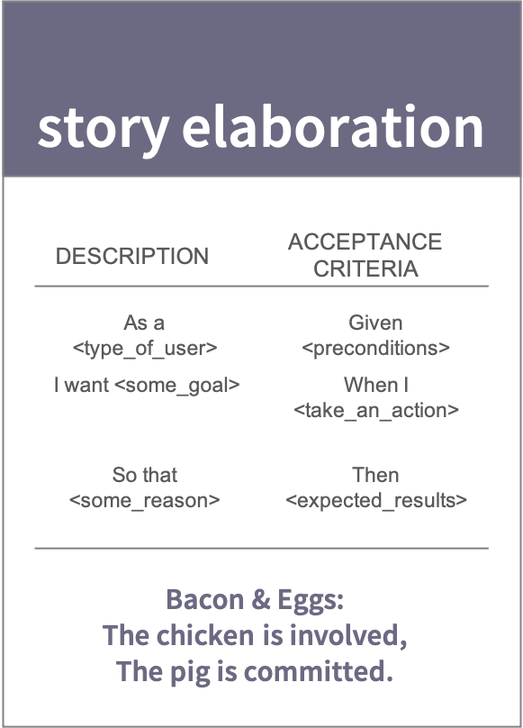
A good story is…
Attainable – must be achievable in order to deliver the requested business value
Cohesive – expresses (as a set) the behavior of the software; resolved any gaps and overlaps
Complete – fully describes the functionality and/or behavior that results in the business need; all supporting artifacts are available
Independent – should articulate a single need or attributes so it can be addressed independently
Maintainable – can be changed without the need to update other requirements
Traceable – while independent, it is related to the other processes within the solution
Verifiable – can be tested to ascertain that the request has been met
Necessary – should record a capability that is needed or specify compliance with a standard
Estimate-able – written so it can be sized as a function of complexity, uncertainty, risk and effort

Slide 4
Story Elaboration
Story Elaboration further defines the functions for a particular iteration:
Brings entire team together to break down functions into stories
Allows the team an opportunity to discuss business cases, process flows and requirements
Size stories so they are of a size that they can be completed – development, testing and acceptance – in a two-week iteration
Recommend the team meets twice a week for ½ an hour

Slide 5
Progressive Story Elaboration Process
Story Title
Story Description
Acceptance Criteria
One line with a brief description of the story
As a <role>
I want to <goal>
So I can <why>
Role – who needs this functionality
Goal – what does the user what to accomplish
Why – why is this functionality important
Presented as scenarios that are testable:
Scenario
Given <preconditions>
When I <take_an_action>
Then <expected_results>
Scenario Outline
Given I have <start> dollars
When I <earn> dollars
Then I have <end> dollars
Examples:
| start | earn | end |
| 10 | 20 | 30 |
| 15| 20 | 35 |

Slide 6
User Story
A concise, written description of a piece of functionality that will be valuable to a user of the software
Title
Brief Title to define the story within its function
Description
Gives clarity as to why a story is useful
Can influence how a story should function and be developed
Can give you ideas for other stories that support the users goal
Acceptance Criteria Syntax
Acceptance Criteria define the boundaries of a user story and are used to confirm when a story is completed and working as intended.
It is readable and understandable by the team
Doesn’t detail how to implement a solution
Enables behavior driven development
Can be automated from a testing perspective
Multiple scenarios can be included in a single story

Slide 7
User Story – Gherkin Syntax
A concise, written description of a piece of functionality that will be valuable to a user of the software
Acceptance Criteria Syntax
Background:
Given a pre-condition that applies to all scenarios
And some other pre-condition
Scenario: Some determinable business scenario
Given some precondition And some other precondition When some action by the actor
And some other action And yet another action Then some testable outcome is achieved And something else we can check happens too
But something else does not happen
Scenario Outline: Eating cucumbers with Examples Given there are <start> cucumbers When I eat <eat> cucumbers Then I should have <left> cucumbers Examples: | start | eat | left | | 12 | 5 | 7 | | 20 | 5 | 15 |
Description Syntax
As a <type of user> I want <some goal> So that <some reason>
<type of user> | Who specifically needs this functionality?
<some goal> | What does the user want to accomplish?
<some reason> | Why is this functionality important?

Slide 8
Acceptance Criteria
Things to Avoid
Using ambiguous language
Using subjective / judgmental language (Better, Good, Allowable)
Using generalizations (All the time, Never, Everyone, Always)
Including observed behavior that is not directly related to the story currently under consideration

Slide 9
User Story Example
Title
Add New Contact
Description
As a member of the sales team
I want to add a new contact
So that I have a central location for this information
Acceptance Criteria Syntax
Background
Given access to the client management system
and role allowed to add contacts
and an authenticated user with that role
Scenario: Add Contact Information
Given contacts in the client management system
When I select the Add New Contact option
and I have a Contact Details page
Then I enter a contact details
and I must enter a contact name, company and phone number
and I can enter additional contact details
and the information will be displayed according to the UX model
Scenario: Save Contact Information
Given …

Slide 10
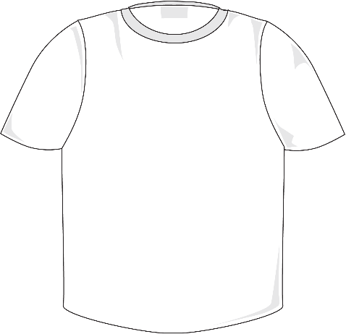


What’s the Point
How we size work
Function T-Shirt Size
Unit that measures complexity, uncertainty, risk and effort of a function
Follows Fibonacci sequence, times 10: 10, 20, 30, 50, 80, 130…
Provided by the team doing the work
XXS Function ~ 1 iteration of work
Story Point
Unit that measures complexity, uncertainty, risk and effort of a story
Follows Fibonacci sequence: 1, 2, 3, 5, 8, 13…
Provided by the team doing the work
One point ~ 1 day of work
XL feature/function is 130 points, ~130 days
Example: Setup cloud infrastructure and CI/CD pipelines (break this down into smaller functions)
XL
130
M function is 50 points, ~50 days
Example: Establish a database schema and setup repository classes
M
50
XXS function is 10 points, ~10 days
Example: CRUD Operations – List, Add, Update and Delete functionality
XXS
10

Slide 11


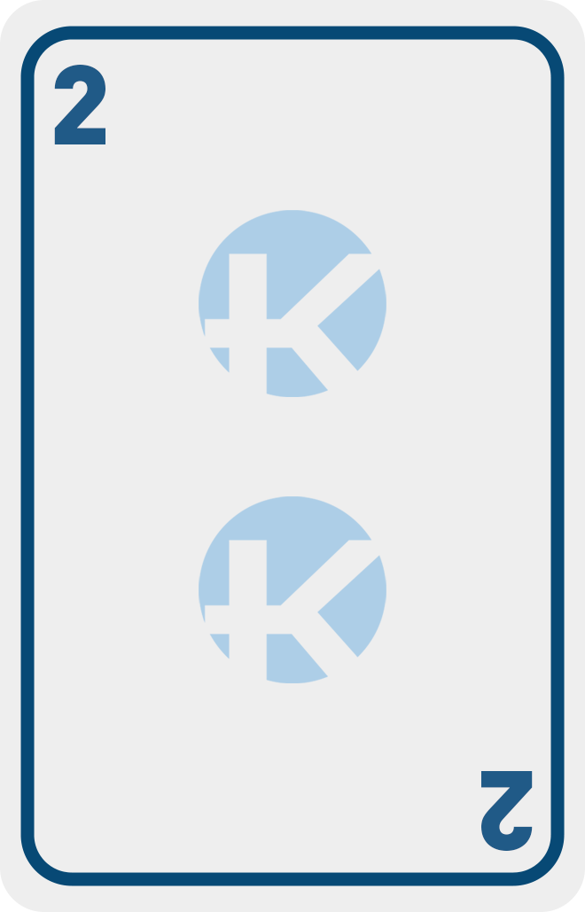
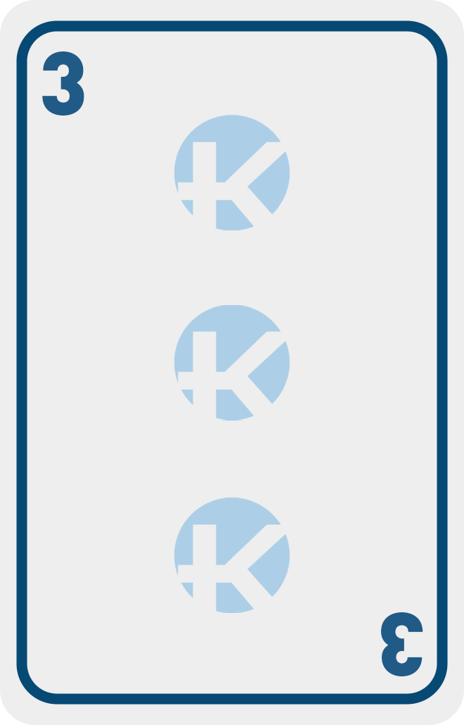
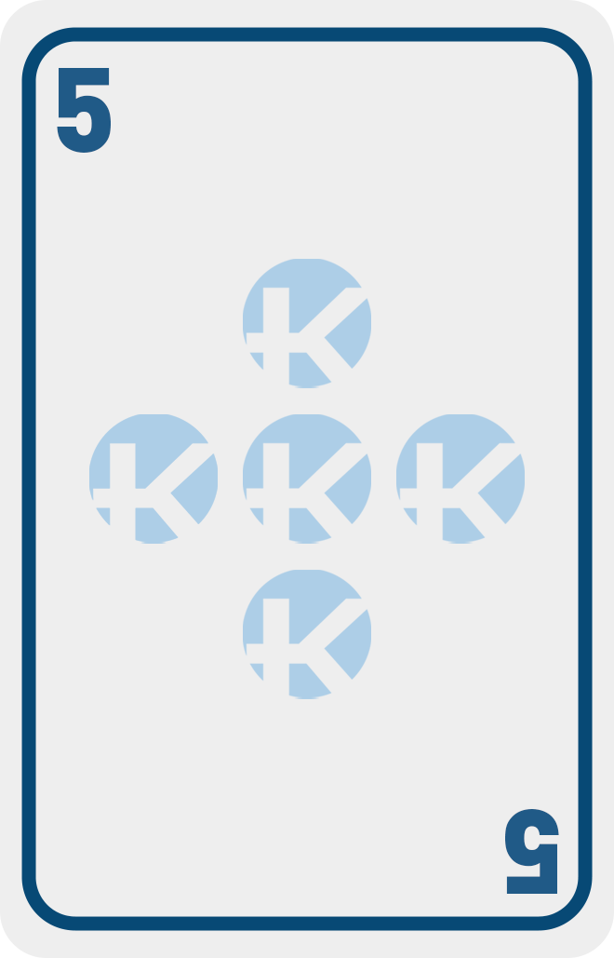
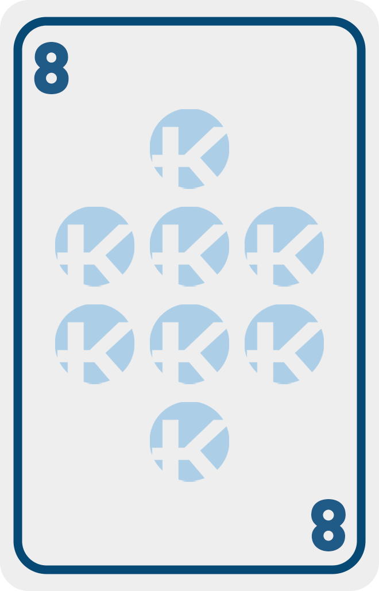
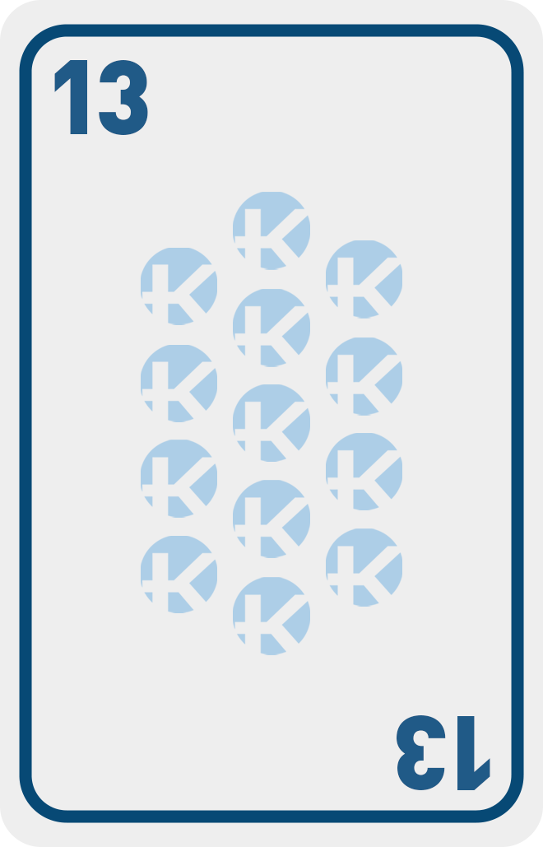
Story Sizing
What’s the Point
Stories are sized to be completed in one iteration. If the story cannot be completed in a single iteration, it is broken into multiple stories.
Unit that measures complexity, uncertainty, risk and effort of a story
Follows Fibonacci sequence: 1, 2, 3, 5, 8, 13…
Provided by the team doing the work
One point ~ 1 day of work
Consider breaking these into smaller stories

Slide 12
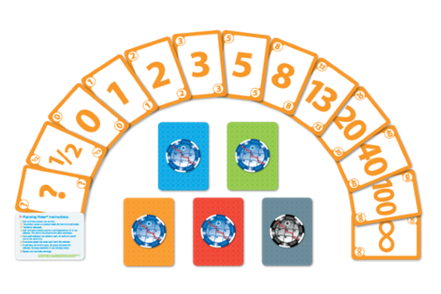
Planning Poker
Analysist reads user story or describes feature to estimators
Each estimator has a deck of Planning Poker cards
Estimators discuss the feature or story, asking questions of the Analyst as needed
When fully discussed, each estimator privately selects one card to represent their estimate
All cards revealed at the same time
If all estimators selected the same value, that becomes the estimate
If not, estimators discuss their estimates and reasons, especially high and low estimators
Again, after discussion, repeat from step 4
Planning poker is repeated until consensus is achieved or estimators decide they need additional information before they can estimate further
Planning Poker Cards by Mountain Goat Software

Slide 13
Story Definition of Ready / Definition of Done
Definition of Ready = Criteria, as agreed on by the team, that determines when a work item is ready to be started. Required for a story to be brought into an iteration.
Definition of Done = Criteria, as agreed on by the team, that determines when a work item is complete. Required for a story to be accepted and a function to be released.

Slide 14
Criteria, as agreed on by the team, that determines when a work item is ready to be started. Required for a story to be brought into an iteration.
Examples:
Story is in system of record and traced back to the function
Acceptance Criteria defined
Story Point Estimates are complete
Design is sufficiently ready
Team understands the story
Small enough to be completed in an iteration, including testing
Business Value is understood
Definition of Ready

Slide 15
Criteria, as agreed on by the team, that determines when a work item is complete. Required for a story to be accepted and a function to be released.
Examples:
Code is checked into code repository
Unit Testing completed and documented
Meets all Acceptance Criteria
Demoed and accepted by Product Owner
All Test scenarios executed successfully
Test cases written and uploaded to tool
Code has been reviewed and the review documented (peer review)
System of record is fully updated
All testing has passed, no open Sev 1 or 2 bugs
Meets all relevant Non-Functional Requirements (NFRs)
Definition of Done

